Slide 1

JDI - Future of UI Automation Let’s work together
Epam Sec Online
Roman Iovlev
January 19, 2016

Slide 2

Agenda
Some words about UI Automation
JDI framework. Main concepts and features.
How to use it simple
Flexibility of framework
Future plans
Let’s work together

Slide 3




Test Automation goals
Reduce Regression testing staff
Speedup Getting actual state
Reduce man issue factor
New tests kinds (areas)
Run by everyone
Constant testing effort
Notes:
Goals and Objectives of Software Test Automation
Reduce Regression testing staff
From men days-weeks to 0
Speedup Getting actual state
From days to minutes-hours or even 0 (in case nightly regressions)
Reduce man issue factor
From high normal to ~0 (because of iterations)
Scalability
Test combinations
Scenarios reuse
New tests kinds (areas)
Big-data testing
Performance testing
Load-testing
- To reduce Testing Cost and Time. - To reduce Redundancy. - To speed up the Testing Process. - To help improve Quality. - To improve Test coverage. - To reduce Manual Intervention.

Slide 4




Side effects
Fast delivery process (time-to-market)
Higher quality
Always actual tests
Scalability
Notes:
Goals and Objectives of Software Test Automation
Reduce Regression testing staff
From men days-weeks to 0
Speedup Getting actual state
From days to minutes-hours or even 0 (in case nightly regressions)
Reduce man issue factor
From high normal to ~0 (because of iterations)
Scalability
Test combinations
Scenarios reuse
New tests kinds (areas)
Big-data testing
Performance testing
Load-testing
- To reduce Testing Cost and Time. - To reduce Redundancy. - To speed up the Testing Process. - To help improve Quality. - To improve Test coverage. - To reduce Manual Intervention.

Slide 5


Business goals
Get same functionality earlier
Release faster
Have higher quality
Cheaper and easier project support
Notes:
Goals and Objectives of Software Test Automation
Reduce Regression testing staff
From men days-weeks to 0
Speedup Getting actual state
From days to minutes-hours or even 0 (in case nightly regressions)
Reduce man issue factor
From high normal to ~0 (because of iterations)
Scalability
Test combinations
Scenarios reuse
New tests kinds (areas)
Big-data testing
Performance testing
Load-testing
- To reduce Testing Cost and Time. - To reduce Redundancy. - To speed up the Testing Process. - To help improve Quality. - To improve Test coverage. - To reduce Manual Intervention.

Slide 6


Manual vs automation
Manual
Automation
New tests creation
Old tests correction
Test Execution
New tests
Regression tests
Analyze results
New tests creation
Old tests correction
Test Execution
New tests
Regression tests
Analyze results
Notes:
Goals and Objectives of Software Test Automation
Reduce Regression testing staff
From men days-weeks to 0
Speedup Getting actual state
From days to minutes-hours or even 0 (in case nightly regressions)
Reduce man issue factor
From high normal to ~0 (because of iterations)
Scalability
Test combinations
Scenarios reuse
New tests kinds (areas)
Big-data testing
Performance testing
Load-testing
- To reduce Testing Cost and Time. - To reduce Redundancy. - To speed up the Testing Process. - To help improve Quality. - To improve Test coverage. - To reduce Manual Intervention.

Slide 7
Manual testing
Notes:
Goals and Objectives of Software Test Automation
Reduce Regression testing staff
From men days-weeks to 0
Speedup Getting actual state
From days to minutes-hours or even 0 (in case nightly regressions)
Reduce man issue factor
From high normal to ~0 (because of iterations)
Scalability
Test combinations
Scenarios reuse
New tests kinds (areas)
Big-data testing
Performance testing
Load-testing
- To reduce Testing Cost and Time. - To reduce Redundancy. - To speed up the Testing Process. - To help improve Quality. - To improve Test coverage. - To reduce Manual Intervention.

Slide 8
Automation testing
Notes:
Goals and Objectives of Software Test Automation
Reduce Regression testing staff
From men days-weeks to 0
Speedup Getting actual state
From days to minutes-hours or even 0 (in case nightly regressions)
Reduce man issue factor
From high normal to ~0 (because of iterations)
Scalability
Test combinations
Scenarios reuse
New tests kinds (areas)
Big-data testing
Performance testing
Load-testing
- To reduce Testing Cost and Time. - To reduce Redundancy. - To speed up the Testing Process. - To help improve Quality. - To improve Test coverage. - To reduce Manual Intervention.

Slide 9
Automation testing
Notes:
Goals and Objectives of Software Test Automation
Reduce Regression testing staff
From men days-weeks to 0
Speedup Getting actual state
From days to minutes-hours or even 0 (in case nightly regressions)
Reduce man issue factor
From high normal to ~0 (because of iterations)
Scalability
Test combinations
Scenarios reuse
New tests kinds (areas)
Big-data testing
Performance testing
Load-testing
- To reduce Testing Cost and Time. - To reduce Redundancy. - To speed up the Testing Process. - To help improve Quality. - To improve Test coverage. - To reduce Manual Intervention.

Slide 10

Automation testing problems
New tests creation
Low-level native tools
We create our own framework
Old tests correction
Custom framework-solution hard to understand
Complex tests/data hierarchy
Analyze results
Not stable tests (false-positive, false-negative)
Not enough fail info(no logging, data sets, tests naming etc.)
Complex architecture
Notes:
Goals and Objectives of Software Test Automation
Reduce Regression testing staff
From men days-weeks to 0
Speedup Getting actual state
From days to minutes-hours or even 0 (in case nightly regressions)
Reduce man issue factor
From high normal to ~0 (because of iterations)
Scalability
Test combinations
Scenarios reuse
New tests kinds (areas)
Big-data testing
Performance testing
Load-testing
- To reduce Testing Cost and Time. - To reduce Redundancy. - To speed up the Testing Process. - To help improve Quality. - To improve Test coverage. - To reduce Manual Intervention.

Slide 11

JDI

Slide 12





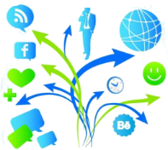
JDI Goals
Accumulate best practices of UI automation (open source, page objects, logging, parallelism etc.)
Multiplatform framework
Intuitive test framework
Stable framework
Flexible framework
Notes:
Goals and Objectives of Software Test Automation
Reduce Regression testing staff
From men days-weeks to 0
Speedup Getting actual state
From days to minutes-hours or even 0 (in case nightly regressions)
Reduce man issue factor
From high normal to ~0 (because of iterations)
Scalability
Test combinations
Scenarios reuse
New tests kinds (areas)
Big-data testing
Performance testing
Load-testing
- To reduce Testing Cost and Time. - To reduce Redundancy. - To speed up the Testing Process. - To help improve Quality. - To improve Test coverage. - To reduce Manual Intervention.

Slide 13


UI Objects Pattern
UI Objects
User elements not only for web (any UI)
Implemented Page Objects (Form, Search, Pagination, Login form etc.)
HTML Elements
User Elements (Button, Label, Table…) in Web
Page Objects
Web elements
Actions with elements
Notes:
Goals and Objectives of Software Test Automation
Reduce Regression testing staff
From men days-weeks to 0
Speedup Getting actual state
From days to minutes-hours or even 0 (in case nightly regressions)
Reduce man issue factor
From high normal to ~0 (because of iterations)
Scalability
Test combinations
Scenarios reuse
New tests kinds (areas)
Big-data testing
Performance testing
Load-testing
- To reduce Testing Cost and Time. - To reduce Redundancy. - To speed up the Testing Process. - To help improve Quality. - To improve Test coverage. - To reduce Manual Intervention.

Slide 14
JDI Examples
@Test
public void menuTest() {
menu.select("Man");
sizes.check("M", "L");
searchButton.click();
Assert.areEquals(results.rows().count(), 4);
Assert.isNotEmpty(
results.row("Best Jacket", column("Title")));
}

Slide 15
JDI Examples
@JPage(url = "http://www.epam.com")
public class JacketPage extends WebPage {
@FindBy(css="") public Menu menu;
@FindBy(css="") public CheckList sizes;
@FindBy(css="") public Button searchButton;
@FindBy(css="") public Table results;
}

Slide 16
Selenium Examples
public class JacketPage {
@FindBy(css="") public List<WebElement> menuElements;
@FindBy(css="") public WebElement menuIsSelected;
@FindBy(css="") public List<WebElement> sizesElements;
@FindBy(css="") public WebElement sizesIsChecked;
@FindBy(css="") public List<WebElement> sizesLabels;
@FindBy(css="") public WebElement searchButton;
@FindBy(css="") public List<WebElement> resultsColumnHeaders;
@FindBy(css="") public List<WebElement> resultsRowsHeaders;
@FindBy(css="") public List<WebElement>resultsCellsHeaders;
@FindBy(css="") public List<WebElement> resultsColumn;
@FindBy(css="") public List<WebElement> resultsRow;
…
}

Slide 17
Selenium Examples
public class JacketPage {
@FindBy(css="") public List<WebElement> menuElements;
...
@FindBy(css="") public List<WebElement> resultsRow;
public void selectElementFromMenu(String name) { … }
public String getSelectedMenuItem() { … }
public boolean isMenuItemSelected(String name) { … }
public void selectElementFromMenu(String name) { … }
…
public int getResultsCount() { … }
public boolean isResultPresent(String name) { … }
public WebElement getSomeAttributeForResult(String name) { … }
…
public List<WebElement> findAllResultsMatch(String name) { … }
}

Slide 18
Examples
@Test
public void shopTest() {
loginPage.open();
loginForm.login(new User("Roman", "test_password"));
search.find("best jacket");
productForm.submit(Products.TestJacket);
pagination.next();
pagination.selectPage(5);
}

Slide 19
Examples
public class LoginForm extends Form<User> {
@FindBy(css="")
public TextField name;
@FindBy(css="")
public TextField password;
@FindBy(css="")
public Button loginButton;
}
public class User {
public String name;
public String password;
public User(String name,
String password) {
this.name = name;
this.password = password;
}
}

Slide 20
Features
Interfaces based elements
Complex UI Objects
Cascade UI Objects Initialization
Multiplatform
Logging for all actions
Stabilization mechanism
Wide Customization abilities
Module-based architecture
Parallel test runs support
…

Slide 21
UI objects hierarchy
Application
Login Page
…
Main Page
Header
Search panel
Search Field
Search Button
FRAME Content (id=‘items’)
Table
Pagination(css=‘.pagination’)
Next button (xpath=‘//input[value=‘Next’]’)
Footer

Slide 22
example
Selenium/Yandex QA Tools
JDI
public class HomePage {
private WebDriver driver;
public HomePage(driver) {
this.driver = driver;
}
…
}
public class MyApplication() {
private HomePage homePage;
public HomePage getHomePage() {
return PageFactory.initElements (driver, HomePage.class);
…
}
public class HomePage {
…
}
public void MyApplication() {
public HomePage homepage;
…
}

Slide 23


Customization
Specified method behavior
Specified element behavior
All objects behavior
Modules (logger, asserter, driver etc.)

Slide 24
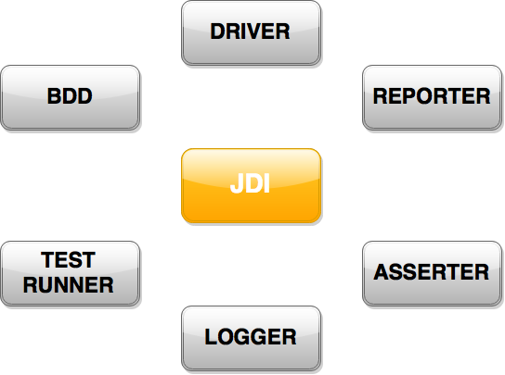
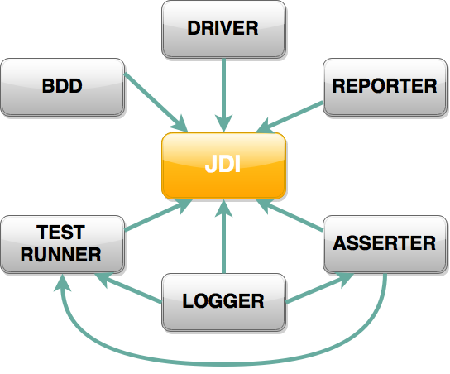

modules

Slide 25
















Our friends

Slide 26
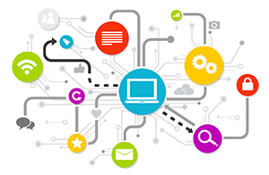
Additional services
UI Objects generator (chrome plugin)
Manual
Auto (microformats)
Layout/view testing
Test run Statistic
Effort free Performance testing
Smart matchers
Base site tests generation
Model-based testing
Site overview/locators testing
Smart test runner

Slide 27

Documentation
JDI Spec (elements and methods description)
Tutorial tests
“Unit tests”
Video tutorial courses
Site

Slide 28

Jdi resolve problems
New tests creation
Low-level native tools
We create our own framework
Old tests correction
Custom framework-solution hard to understand
Complex tests/data hierarchy
Analyze results
Not stable tests (false-positive, false-negative)
Not enough fail info (no logging, data sets, tests naming etc.)
Complex architecture

Slide 29

Business goals
Get same functionality earlier
Release faster
Have higher quality
Cheaper and easier project support
Notes:
Goals and Objectives of Software Test Automation
Reduce Regression testing staff
From men days-weeks to 0
Speedup Getting actual state
From days to minutes-hours or even 0 (in case nightly regressions)
Reduce man issue factor
From high normal to ~0 (because of iterations)
Scalability
Test combinations
Scenarios reuse
New tests kinds (areas)
Big-data testing
Performance testing
Load-testing
- To reduce Testing Cost and Time. - To reduce Redundancy. - To speed up the Testing Process. - To help improve Quality. - To improve Test coverage. - To reduce Manual Intervention.

Slide 30

About you
Want to try?
Have some ideas?
Already have best UI Framework?
Want to help us improve JDI?
…

Slide 31

Let’s work together

Slide 32

Let’s work together
Skype: roman.iovlev
Email: roman_Iovlev@epam.com
GitHub: https://github.com/epam/JDI (https://github.com/ggasoftware/gga-selenium-framework)

